Slide 1
Relationships II
Chapter 5

Slide 2
Illustration/Example Words
(for) example
(for) instance
Such as
Including
Specifically
To be specific
(as an) illustration
To illustrate
One
once

Slide 3
Comparison Words
(just) as
(just) like
Alike
Same
Both
Equally
Resemble
Likewise
In like fashion
In like manner
Similar(ly)
Similarity
In a similar fashion
In a similar manner
In the same way
In common

Slide 4
Contrast Words
But
Yet
However
Although
Nevertheless
Still
Instead of
In contrast
On the other hand
(On the) contrary
Converse(ly
Opposite
Even though
As opposed to
In spite of
Despite
Rather than
Difference
Differently
Differ (from)
Unlike
while

Slide 5
Cause and Effect Words
Therefore
Thus
(as a) consequence
Consequently
Due to
So
As a result
Results in
Leads (led) to
Since
Owing to
Effect
Cause
If… then
Affect
Because (of)
Reason
Explanation
Accordingly
Depends on

Slide 6
On ten Santa Fe walls, the history of the Chicanos, both mythical and actual, is depicted in brilliant colors and disproportionate figures. Aztec medicine figures dance and gods protect peasants, all for the glory of the Chicano in the present. On some walls, the chains of bondage are being broken and the Lady of Justice, depicted as an Indian Maiden, watches over both Indians and Chicanos. On others, Pancho Villa and Father Hidalgo lead the Mexican peasants to freedom. But the clenched fist at the end of the grotesquely muscled arms is the most predominant image. It symbolizes unity, determination, ambition, and pride, all traits that Los Artes believe should be a part of Chicano psychology. The figures they paint are bold, upright, strong, and grasping, far from the stereotype of the Mexican-American with drooping moustache and floppy sombrero lying in the shade of a stucco building. (Folk Art in the Barrios by Eric Kroll)

Slide 7
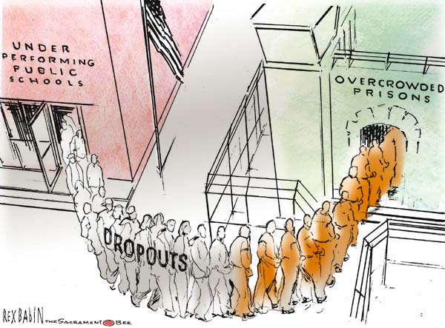

Slide 8
Only two animals have entered the human household otherwise than as prisoners and become domesticated by other means than those of enforced servitude: the dog and the cat. Two things they have in common, namely, that both belong to the order of carnivores and both serve man in their capacity of hunters. In all other characteristic, above all in the manner of their association with man, they are as different as the night from the day. There is no domestic animal that has so radically altered its whole way of living, indeed its whole sphere of interests, that has become domestic in so true a sense as the dog; and there is no animal that, in the course of its centuries-old association with man, has altered so little as the cat. There is some truth in the assertion that the cat, with the exception of a few luxury breeds, such as Angoras, Persians, and Siamese, is no domestic animal but a completely wild being. Maintaining its full independence it has taken up its abode in the houses and outhouses of man, for the simple reason that there are more mice there than elsewhere. The whole charm of the dog lies in the depth of friendship and the strength of the spiritual ties with which he has bound himself to man, but the appeal of the cat lies in the very fact that she has formed no close bond with him, that she has the uncompromising independence of a tiger or a leopard while she is hunting in his stables and barns, that she still remains mysterious and remote when she is rubbing herself gently against the legs of her mistress or purring contentedly in front of the fire. (Dogs and Cats by Konrad Lorenz)

Slide 9
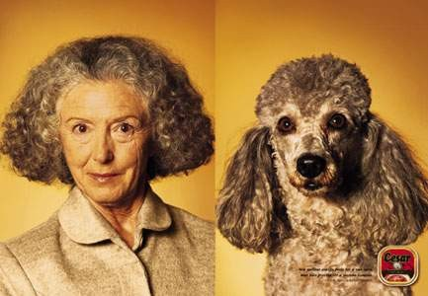

Slide 10
To save money in the early 1980s, Illinois released 21,000 prisoners an average of three months early. James Austin of the National Council on Crime and Delinquency calculates that the early releases produced 23 homicides, 32 rapes, 262 arsons, 681 robberies, 2,472 burglaries, 2,571 assaults and more than 8,000 other crimes. According to Harvard researchers David P. Cavanaugh and Mark A. R. Kleiman, the $60 million the state saved cost Illinois crime victims $304 million, directly or indirectly. (“Pay Now-Or Pay Later” by Eugene H. Methvin

Slide 11
