Slide 1
Annotation: In college, you can write in your book!

Slide 2
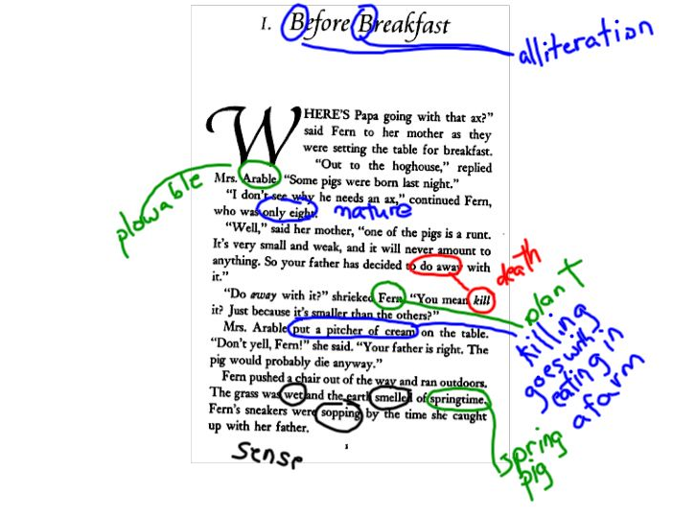
How do students make annotations?
an·no·tate
/ˈanəˌtāt/
Verb
Add notes to (a text or diagram) giving explanation or comment.
Synonyms
comment - note - gloss

Slide 3
What does annotation mean?
an·no·ta·tion
/ˌanəˈtāSHən/
Noun
A note by way of explanation or comment added to a text or diagram. The action of annotating a text or diagram.
Synonyms
note - comment - gloss - remark - notation - commentary
P
?
*
______________
+/-/=

Slide 4
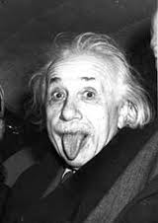
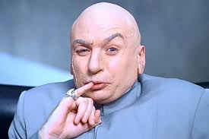
Who makes annotations?
annotator
/ˈanəˌtāt/or
Noun
A commentator who writes notes to a text. A student who takes deliberate actions to understand text. You do! Synonyms reader, student, commentator, genius

Slide 5
When do good readers annotate?
You were right-
Good readers annotate throughout the stages of the reading process.

Slide 6
The Reading Process: Annotate throughout all three stages of the reading process.
Before Reading
Survey
While Reading
Read
Recite
Record
After Reading
Review

Slide 7
You’re thinking….
If I take time to write all that stuff, I’m going to have less time to read.
You’re Right!

Slide 8
Abbreviate!
The great thing about annotation is that we can abbreviate and use symbols to save time!

Slide 9
Annotation before you read:
Survey
Connect to the title
Read the introduction
LOOK through the chapter
Scan headings, summaries,
activities, main points
Look at Graphics

Slide 10
While You Survey
Question
Set a purpose for reading
“Why am I reading this?”
Identify author’s purpose
“Why was this written?”
Ask questions about your survey:
headings
summaries
activities
main points
????

Slide 11
Pre Reading: What is your purpose for reading?
Answers could be:
“I am reading to learn; we have been discussing identity- I should be looking for information about identity.”
“I am reading to learn; we are studying cell meiosis- I should be looking for steps in the process of cell division.”
What are other reasons we read?

Slide 12
Pre Reading: What is the Author’s Purpose
Answers could be:
“A psychologist wrote this- psychologists study the human mind, so the author’s purpose is to teach me about identity.”
“A corporation wrote this- it is trying to persuade me to buy this.”
What are other possible answers?

Slide 13
Suggestions for Pre Reading Abbreviation
Annotation | Meaning | Symbols
Prediction | An inference about what the text is about | P= ____________
Author’s Purpose | The reason the author is writing | AP=
Reader’s Purpose | The reason you are reading | RP=
Question | Something seems strange- I need more information | ?

Slide 14
For Example:
The Multiple Parts of the Self
By Gerald Young Ph. D in Rejoining Joy
Dan felt he did not know himself. "Who am I? What is important to me? I cannot figure that out." He asked questions like these, and moved from one opinion about his core self to another, to the exasperation of his parents. Salem felt the same way, but she related her angst to her feminine identity and culture. "I'm trying to strike out on a different path, but family tell me what to do. They are too old country for me.“
RP= To learn more about identity
AP= to inform?
P= many parts to identity
?

Slide 15
Annotation During Reading
Read and Recite
As you read, stop to say things back to yourself
Make note of unknown/Important vocabulary
and practice pronouncing the vocab
Read and Record
Make connections with what you are reading
Make inferences
Identify main ideas
Summarize
Analyze

Slide 16
Annotate the essentials: Not everything is important!

Slide 17
More Abbreviations:
Annotation | Meaning | Symbol
Vocab | Look up unknown words and make note of unfamiliar words that are used often. | Circle them; then, define them.
Questions | Write questions directly on the text. | Q
Connections | Try to connect the information in the text to things you already know. | C
Inferences | If the author isn’t direct, think about what is being implied. | Inf
Main Ideas | Write down main ideas. Stated main ideas can be underlined. | MI
Summary | Summarize the information to help yourself remember it. | S
Analysis | Compare your opinions and understanding to what the author is writing. Is it logical? Is it reasonable? Does it make sense? | A

Slide 18
Vocabulary
Identify vocabulary that is unknown.
Look for vocabulary that seems essential to the passage.
Provide synonyms after you’ve looked up the definition.
The Multiple Parts of the Self
By Gerald Young Ph. D in Rejoining Joy
Dan felt he did not know himself. "Who am I? What is important to me? I cannot figure that out." He asked questions like these, and moved from one opinion about his core self to another, to the exasperation of his parents. Salem felt the same way, but she related her angst to her feminine identity and culture. "I'm trying to strike out on a different path, but family tell me what to do. They are too old country for me.“
frustration
center
anxiety

Slide 19
Ask Questions
Question the Author
Make note of things you’re uncertain of
Question relevance
The Multiple Parts of the Self
By Gerald Young Ph. D in Rejoining Joy
Dan felt he did not know himself. "Who am I? What is important to me? I cannot figure that out." He asked questions like these, and moved from one opinion about his core self to another, to the exasperation of his parents. Salem felt the same way, but she related her angst to her feminine identity and culture. "I'm trying to strike out on a different path, but family tell me what to do. They are too old country for me.“
Q=Why is the author discussing gender?
Q=What does family have to do with identity?

Slide 20
Make Connections
How does the text relate to your community or family?
How does the text relate to something else you’ve read?
How does this relate to you?
The Multiple Parts of the Self
By Gerald Young Ph. D in Rejoining Joy
Dan felt he did not know himself. "Who am I? What is important to me? I cannot figure that out." He asked questions like these, and moved from one opinion about his core self to another, to the exasperation of his parents. Salem felt the same way, but she related her angst to her feminine identity and culture. "I'm trying to strike out on a different path, but family tell me what to do. They are too old country for me.“
C=my parents seem frustrated with me sometimes, too.
C=We read that poem a while ago about “self knowledge.” Dan and Salem need to read that poem.

Slide 21
Make Inferences
When meaning is implied, readers have to make inferences to understand the author’s point or main idea. We can help ourselves keep track of inferences by writing them down.
The Multiple Parts of the Self
By Gerald Young Ph. D in Rejoining Joy
Dan felt he did not know himself. "Who am I? What is important to me? I cannot figure that out." He asked questions like these, and moved from one opinion about his core self to another, to the exasperation of his parents. Salem felt the same way, but she related her angst to her feminine identity and culture. "I'm trying to strike out on a different path, but family tell me what to do. They are too old country for me.“
Inf=People’s understanding of identity can change.
-It’s hard to figure out my identity when people are making decisions for me.

Slide 22
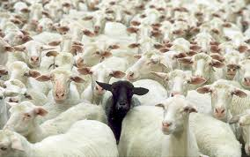
Main Idea
We know that identifying main idea is one of the most important skills for readers:
Ask yourself if the main idea is stated or implied
Look for topic sentences and thesis statements
Be aware of the different kinds of details that the author uses in support of the main idea
explanations, examples, facts?

Slide 23
Main Idea: Stated or Implied?
MI= implied because there’s no topic sentence. Author is using examples to show that family can pressure and gender plays a part in identity.
The Multiple Parts of the Self
By Gerald Young Ph. D in Rejoining Joy
Dan felt he did not know himself. "Who am I? What is important to me? I cannot figure that out." He asked questions like these, and moved from one opinion about his core self to another, to the exasperation of his parents. Salem felt the same way, but she related her angst to her feminine identity and culture. "I'm trying to strike out on a different path, but family tell me what to do. They are too old country for me.“

Slide 24
Summarize
When you finish a portion of the text, try to summarize the main points to make it easier for you to remember.
The Multiple Parts of the Self
By Gerald Young Ph. D in Rejoining Joy
Dan felt he did not know himself. "Who am I? What is important to me? I cannot figure that out." He asked questions like these, and moved from one opinion about his core self to another, to the exasperation of his parents. Salem felt the same way, but she related her angst to her feminine identity and culture. "I'm trying to strike out on a different path, but family tell me what to do. They are too old country for me.“
S=Family and gender roles can sometimes make understanding who we are more difficult.

Slide 25
Analyze
Once you’ve figured out the author’s point, analyze his message against your own understanding about the topic.
The Multiple Parts of the Self
By Gerald Young Ph. D in Rejoining Joy
Dan felt he did not know himself. "Who am I? What is important to me? I cannot figure that out." He asked questions like these, and moved from one opinion about his core self to another, to the exasperation of his parents. Salem felt the same way, but she related her angst to her feminine identity and culture. "I'm trying to strike out on a different path, but family tell me what to do. They are too old country for me.“
A=I see what the author is saying, but sometimes family can be helpful, too. My grandma helps me see the things I’m good at. I’ve felt pressure to be a certain way because of my gender, too, but I never really thought of it that way.

Slide 26
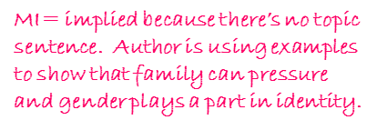
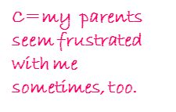
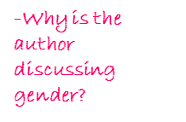
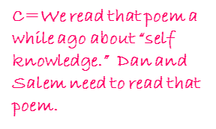
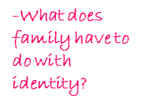
Take a second to look at it all together: Review
The Multiple Parts of the Self
By Gerald Young Ph. D in Rejoining Joy
Dan felt he did not know himself. "Who am I? What is important to me? I cannot figure that out." He asked questions like these, and moved from one opinion about his core self to another, to the exasperation of his parents. Salem felt the same way, but she related her angst to her feminine identity and culture. "I'm trying to strike out on a different path, but family tell me what to do. They are too old country for me.“

Slide 27
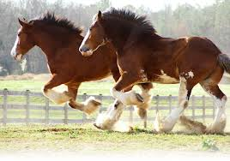
WHOA!!

Slide 28
Let’s Reflect for a Minute
Your Annotations should be a reflection of SQ4R
You should always know WHY you have annotated a particular part of a passage
As you practice doing this, it get’s easier
Eventually, you should be SQ4Ring without even realizing it.
Write down two ways SQ4R can help readers

