Slide 1

Deborah Fontaine
Iris Strunc
strunci@nwfsc.edu

Slide 2
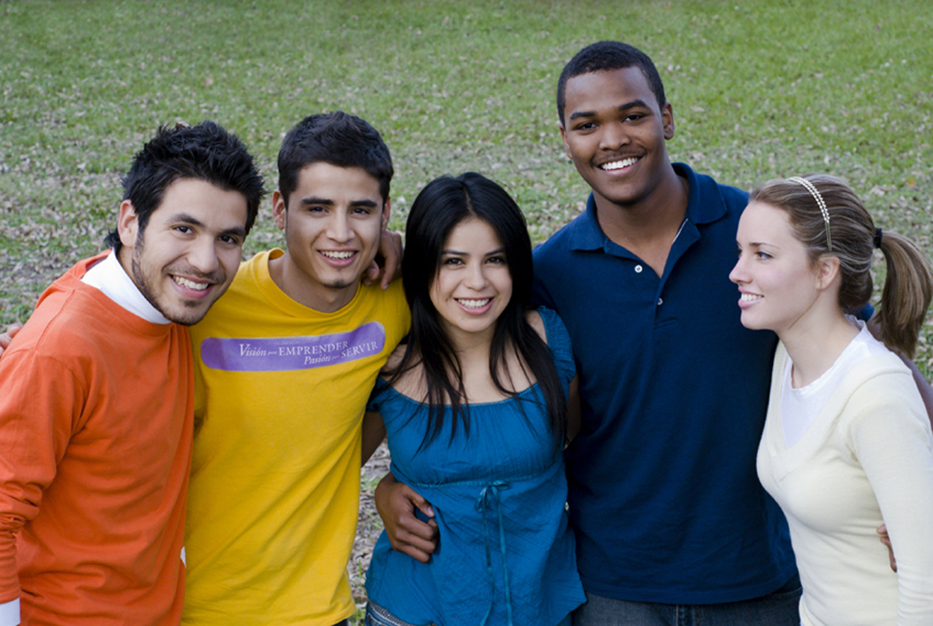
Connecting Pieces in a Text: Strategies for Identifying Inferences

Slide 3
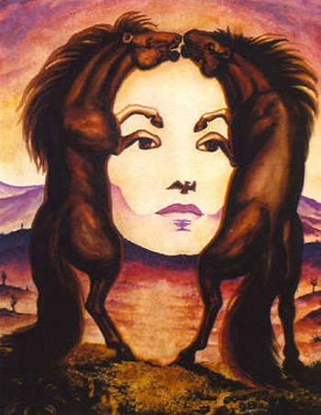

Slide 4
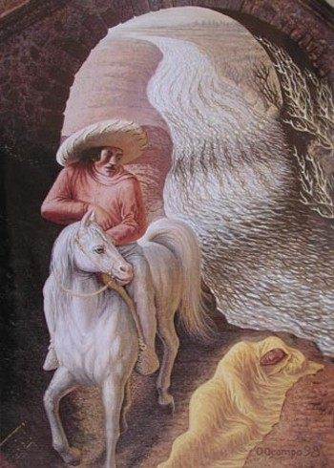

Slide 5


Slide 6
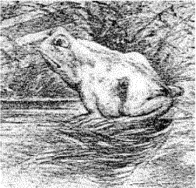

Slide 7
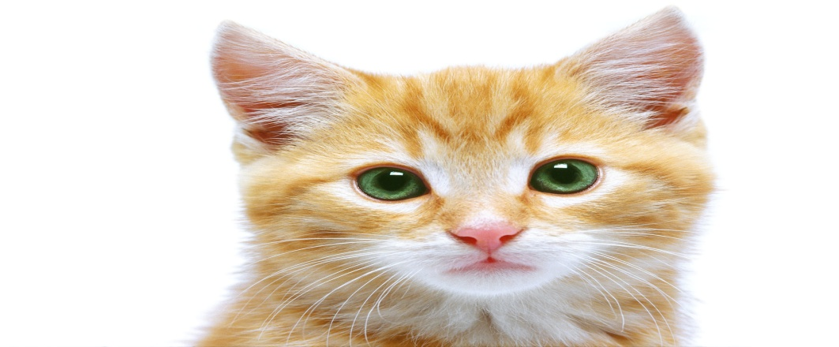
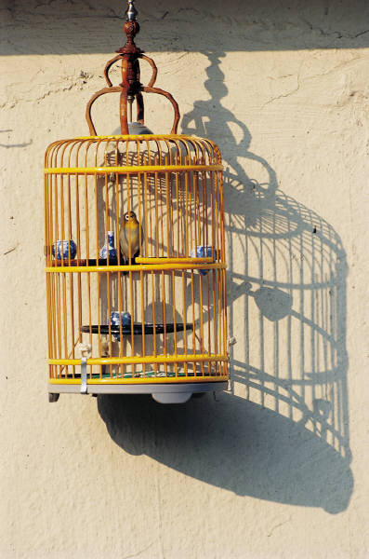
Inferences
You walk into a room and see blood on the floor, an empty birdcage, and a purring cat who is licking its paw. You put the clues together and conclude that . . .
Notes:
You have just made an inference or an informed conclusion.
When critically reading the textbooks for your college classes, you also use clues to make inferences.
By reading between the lines, you can discover meaning that is not directly stated by the author.

Slide 8
Knock knock.
Who's there?
Cargo.
Cargo who?
Cargo BEEP BEEP!

Slide 9
Knock knock.
Who's there?
Tennis!
Tennis who?
Ten is my favorite number!

Slide 10

Knock knock.
Who's there?
Wendy.
Wendy who?
Wendy wind blows de cradle will rock.

Slide 11

Your students know how to make inferences
They make inferences throughout the day.
They make inferences based on their peers’ physical appearances, actions, speech, or based on their teacher’s facial expressions, body language and room arrangement.
Model for them how to transfer those skills and strategies they already know to the passages they read.

Slide 12
Think about what you might infer if you saw each of the following:
1. A high school has uniformed security guards patrolling the halls.
2. A dog cringes when someone tries to pet him.

Slide 13
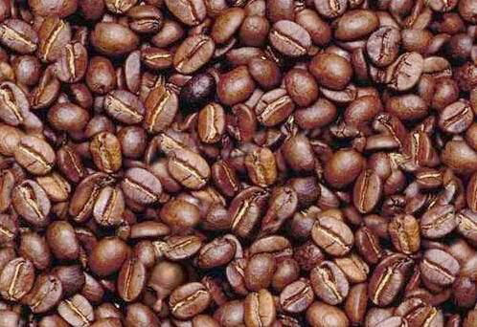
Where is the hidden man?

Slide 15

When first introducing “inferential reading” to students, use an everyday occurrence where they automatically draw inferences
Design an activity that uses an inductive approach to identify the types of inferences that they constantly use in their daily activities.

Slide 16
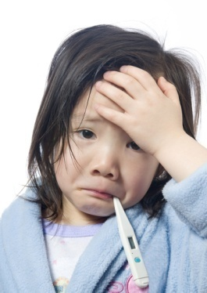
Medicine
Symptoms (details):
--low grade fever
--non-productive cough
--sneezing
--fatigue
Diagnosis (inference/conclusion)
--virus/common cold

Slide 17
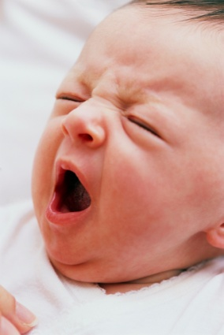
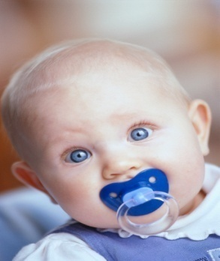

Medicine
Symptoms (details):
--fussy baby
--drooling
--gumming toys or hands
--difficulty sleeping
Diagnosis (inference/conclusion)
--teething

Slide 18
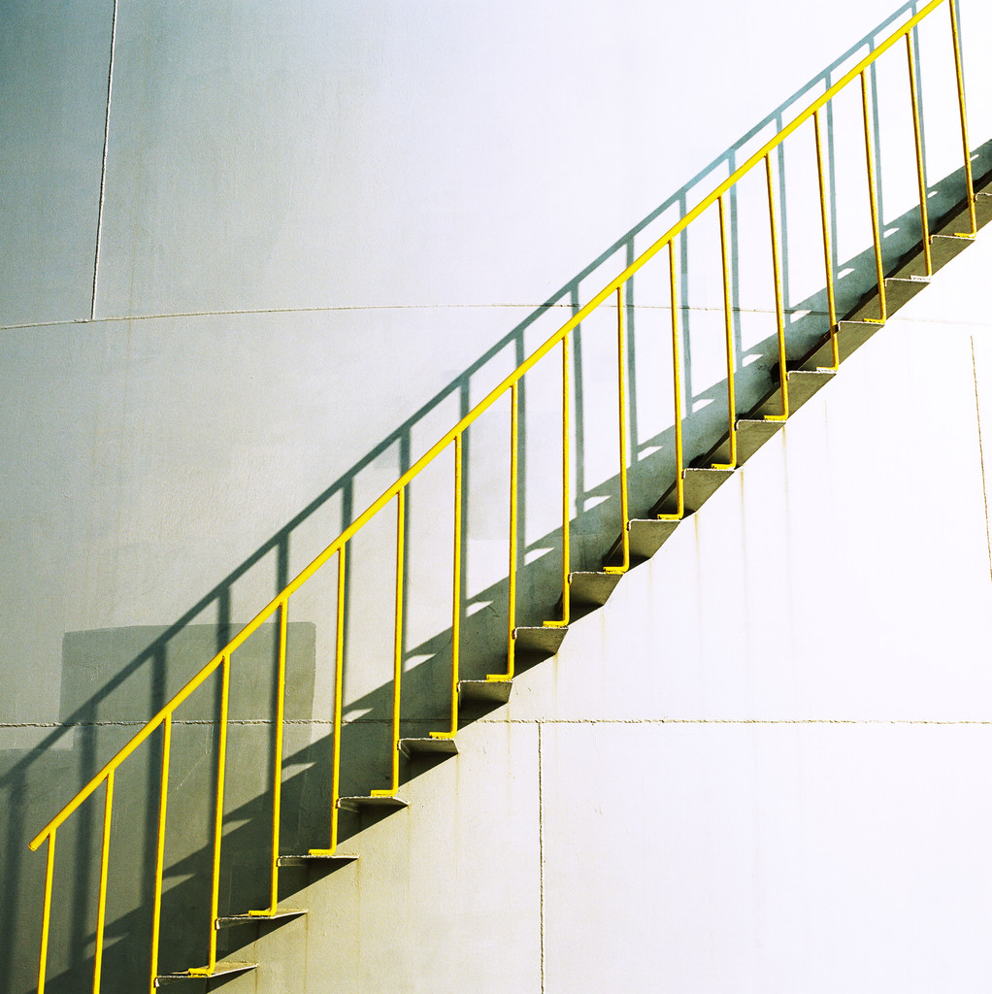
WHAT GOES UP AND DOWN IN ALL KINDS OF BUILDINGS.... BUT NEVER MOVES?
stairs
Notes:
Riddles are a great way to begin teaching inferences.

Slide 19

What always runs but never walks, often murmurs, never talks, has a bed but never sleeps, has a mouth but never eats?
A river

Slide 20
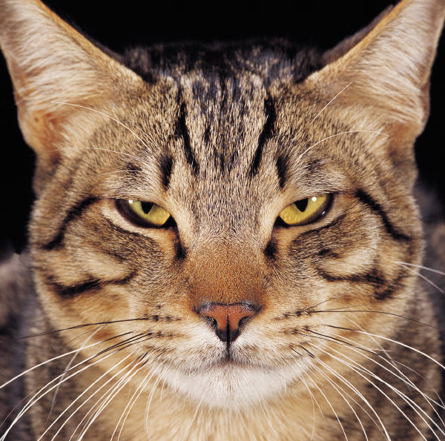
Riddles
This is a very old rhyming riddle. See if you can answer it by reading and thinking very carefully.
As I was going to Saint Ives,
I crossed the path of seven wives.
Every wife had seven sacks,
Every sack had seven cats,
Every cat had seven kittens,
Kittens, cats, sacks, wives,
How many were going to Saint Ives?

Slide 21
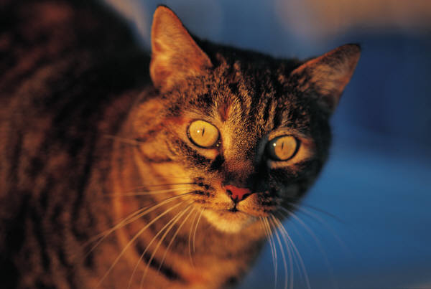
Riddles
This is a very old rhyming riddle. See if you can answer it by reading and thinking very carefully.
As I was going to Saint Ives,
I crossed the path of seven wives.
Every wife had seven sacks,
Every sack had seven cats,
Every cat had seven kittens,
Kittens, cats, sacks, wives,
How many were going to Saint Ives?

Slide 22

It is greater than God and more evil than the devil
The rich need it
The poor have it
If you eat it, you will die
Who am I ?
nothing

Slide 23
Language can be manipulated.
Notes:
Understanding that words and sentences can have more than one meaning improves comprehension by allowing readers to think flexibly about what the appropriate meaning may be.
To evaluate and regulate comprehension of text, it is necessary to know that the words in a text can add up to more than one possible meaning and that context and alternative explanations need to be considered.
This ability to reflect upon and manipulate language is crucial for reading.

Slide 24
My Resume
My first job was working in an Orange Juice factory, but I got canned.
I couldn't concentrate.
Next, I tried working in a Muffler Factory, but that was
too exhausting.
Then, I tried to be a Chef - figured it would add a
little spice to my life,
but I just didn't have the thyme.
Finally, I attempted to be a Deli Worker, but any way I
sliced it I couldn't cut the mustard.

Slide 25
My Resume
My first job was working in an Orange Juice factory, but I got canned.
I couldn't concentrate.
Next, I tried working in a Muffler Factory, but that was
too exhausting.
Then, I tried to be a Chef - figured it would add a
little spice to my life,
but I just didn't have the thyme.
Finally, I attempted to be a Deli Worker, but any way I
sliced it I couldn't cut the mustard.

Slide 26
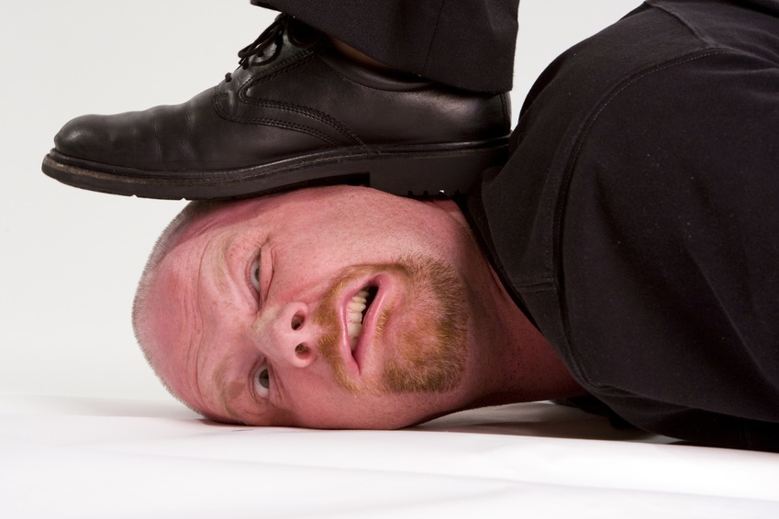
Your turn. . . Create a an entry for your resume. Choose from lumberjack, tailor, musician, doctor, surgeon
Notes:
Choose a partner. Pick a job. Write two descriptions that are attached to the job which could be ambiguous.
My first job was working in an orange juice factory, but I got canned because I couldn't concentrate.
Then I worked in the woods as a LUMBERJACK but I just couldn't hack it, so they gave me the ax.
After that, I tried to be a TAILOR, but I just wasn't suited for it, mainly because it was a so-so job.
Next, I tried working in a muffler factory, but that was too exhausting.
Then I tried to be a chef -- figured it would add a little spice too my life, but I just didn't have the thyme.
I attempted to be a deli worker, but any way I sliced it I couldn't cut the mustard.
My best job was being a MUSICIAN, but eventually I found I wasn't noteworthy.
I studied a long time to become a SURGEON, but I didn't have any patience.
Next was a job in a shoe factory; I tried, but I just didn't fit in.
I became a professional fisherman, but discovered that I couldn't live on my net income.
I managed to get a good job working for a pool maintenance company, but the work was just too draining.
So then I got a job in a workout center, but they said I wasn't fit for the job.
After many years of trying to find steady work, I finally got a job as a historian, until I realized there was no future in it.
My last job was working at Starbucks, but I had to quit because it was always the same old grind.
I was a soldier who survived mustard gas and pepper spray; now I’m a seasoned veteran.
My last job was working as a doctor, but I lost patients.
My last job was working as a surgeon, but my heart just wasn’t in it.
My last job was to be the Energizer Bunny, but I was arrested and charged with battery.
I worked for a butcher in my last job, but I got a little behind in my work when I backed into the meat grinder.
My last job was a ballet dancer, but I found it to be too-too difficult.
SO I RETIRED, [Firestone] AND I FOUND I AM PERFECT FOR THE JOB!

Slide 27

Cairns (1999) pointed out that the majority of the 1,000 most common words in English are multi-meaning and ambiguous.

Slide 28
A vulture boards an airplane, carrying two dead raccoons. The stewardess looks at him and says, "I'm sorry, sir, only one carrion allowed per passenger."
Two Eskimos sitting in a kayak were chilly, so they lit a fire in the craft. Unsurprisingly it sank, proving once again that you can't have your kayak and heat it too.
A group of chess enthusiasts checked into a hotel and were standing in the lobby discussing their recent tournament victories. After about an hour, the manager came out of the office and asked them to disperse.
"But why?" they asked, as they moved off. "Because", he said, "I can't stand chess-nuts boasting in an open foyer."

Slide 29
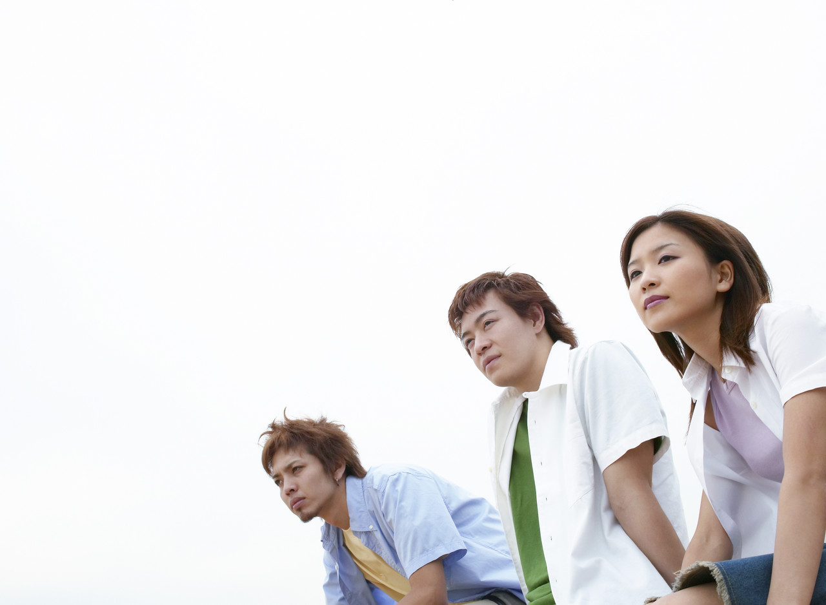
What Am I?

Slide 30
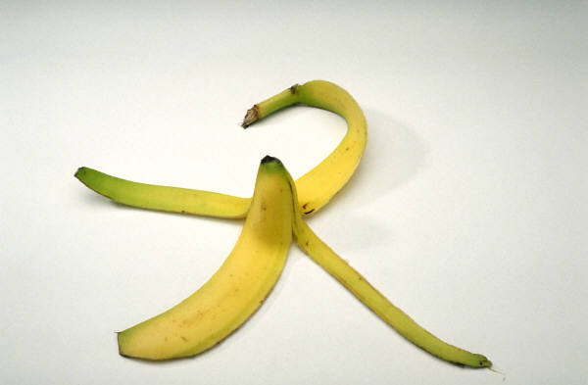
I am eaten
I am come from South America
I am a fruit
I come with a peel
I grow on trees upside down
Some people eat me with cereal
I can be frozen
I might have a Chiquita label
Monkeys love me
I am a BANANA

Slide 31
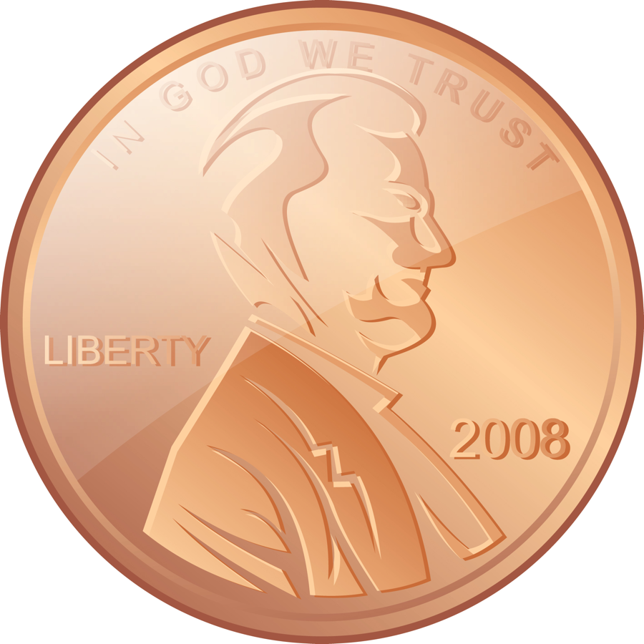
I am round
My favorite number is one
I am made by the government
I am made of copper
A president’s face is on me
I am a kind of money
I am lucky if you pick me up
People make a wish on me
I am thrown into fountains
I am a PENNY

Slide 32
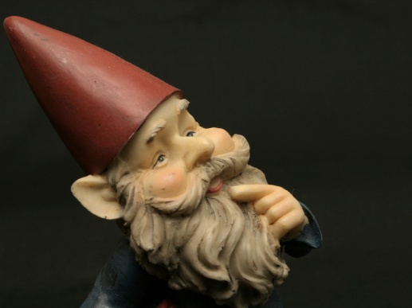
What can you infer?

Slide 33
Mike likes bananas, but not apples.
Mike likes lemons, but not limes.
Mike likes daffodils, but not poppies.
Things that are yellow.
Cindy likes dimes, but not nickels.
Cindy likes toes, but not feet.
Cindy likes October, but not November.
Things that have to do with ten.

Slide 34
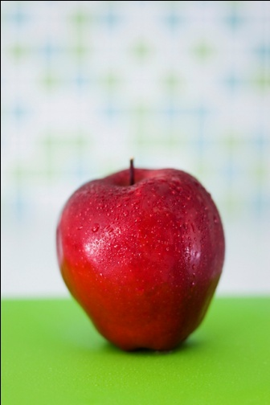
Betty likes apples, but not applesauce.
Betty likes potato chips, but not mashed potatoes.
Betty likes crackers, but not bread.
Things that are crunchy
Tom likes books, but not novels.
Tom likes beans, but not carrots.
Tom likes bicycles, but not motorcyles.
Things that start with a B

Slide 35
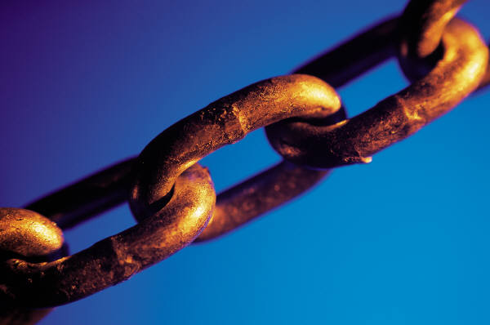
Inferring through Making
Connections
Critical readers are able to think inferentially when they connect their background of information, ideas, and experiences with text.

Slide 36
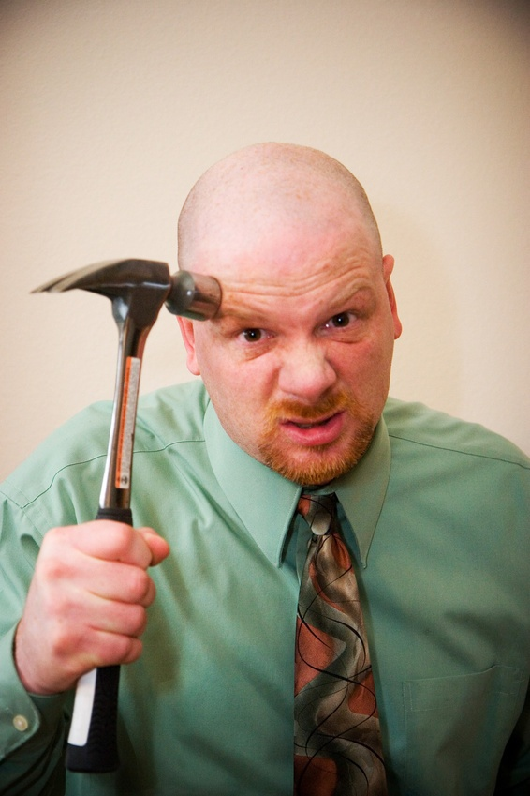
I know a word of letters three. Add two, and fewer there will be
Few
E R

Slide 37
Question:
A girl who was just learning to drive went down a one-way street in the wrong direction, but didn't break the law. How?
She was walking

Slide 38

It is necessary to recognize the difference between an inference/
conclusion question and a supporting detail question

Slide 39

Inferring through Questioning
Language provides clues to thinking.

Slide 40

What kind of question is this?
Supporting Details
According to the passage…
The author states…
Inferences/Conclusions
Based on the passage we can infer/conclude
The author suggests…
The author implies…

Slide 41

Inferring through Background Knowledge
Word Clues
+ Experience
Inference

Slide 42
Inference
“When you read, you must use all your senses. You see things in your ‘mind’s eyes’ and hear the sounds you connect to that about which you are reading.”
Guided Reading the Four Blocks Way

Slide 43
In reading we make logical leaps from the information given in a straightforward way to ideas that are not stated directly.

Slide 44
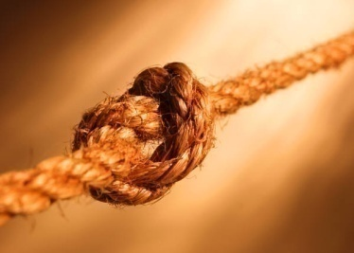
Solve the mystery. . .
Someone killed Mr. Body. Miss Scarlett is holding a knife. Professor Plum is carrying a candlestick. Mrs. Peacock is coiling up rope. The coroner has determined the cause of death was by hanging.
Who is holding a candlestick? (supporting detail)
Who does the evidence suggest is the murderer? (inference/conclusion)

Slide 45
Inferences and pictures

Slide 46
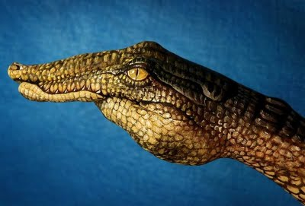

Slide 47
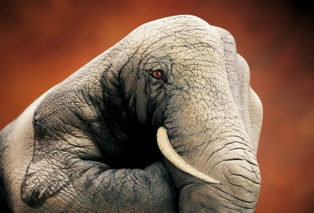

Slide 48
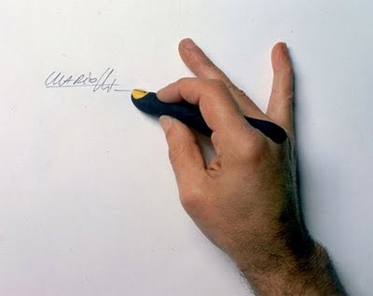

Slide 49
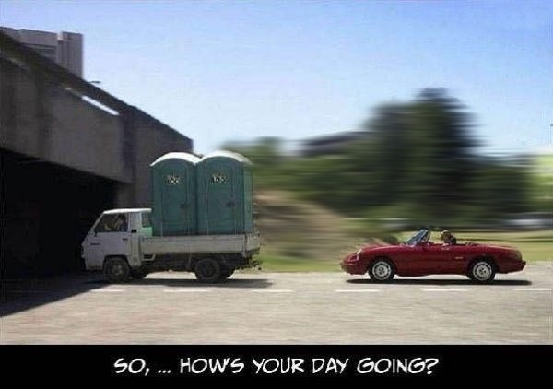

Slide 50
What can you infer from this picture?
What are the details?

Slide 51
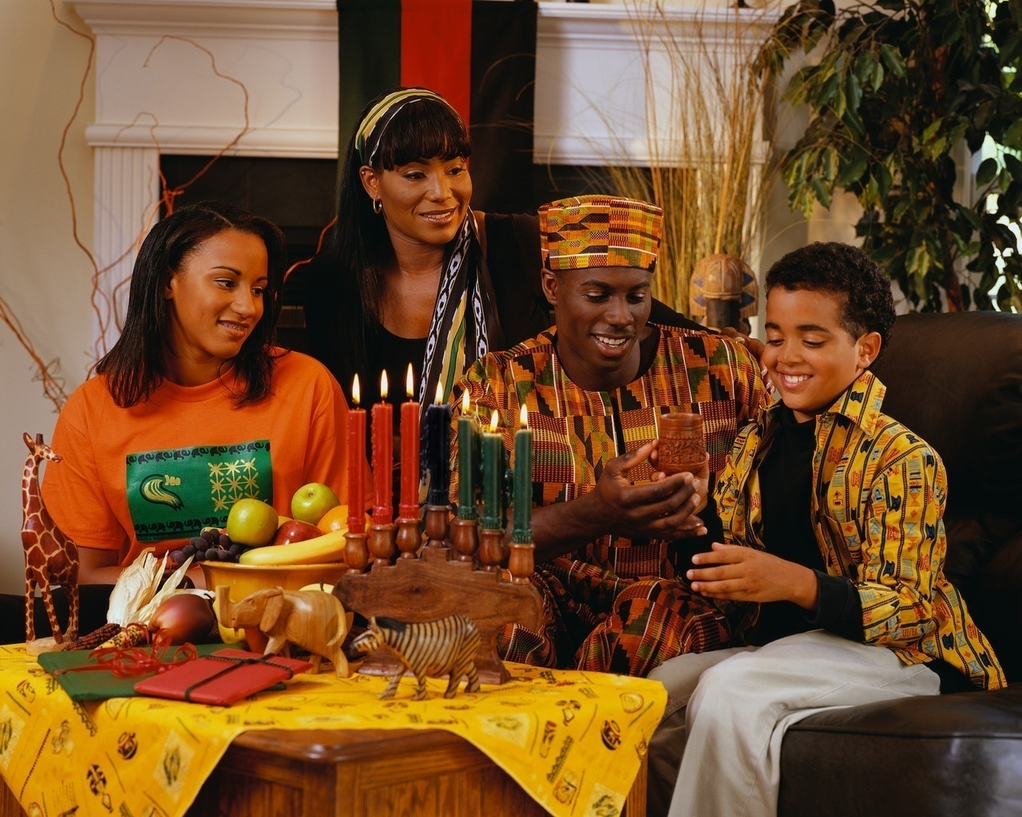

Slide 55
Bright colors
fruit
Candles
Chalise

Slide 56
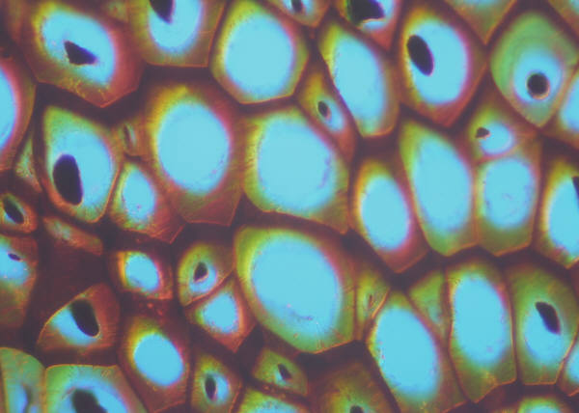
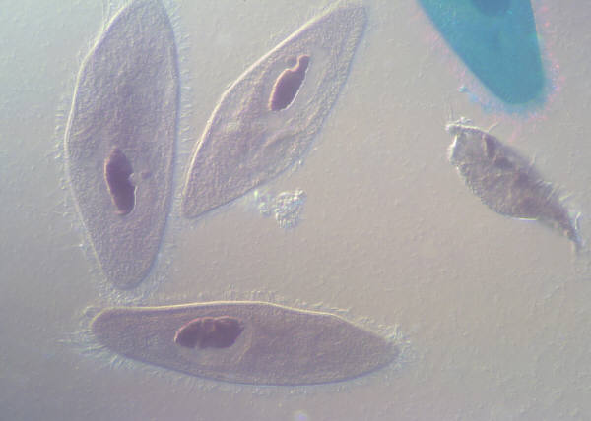
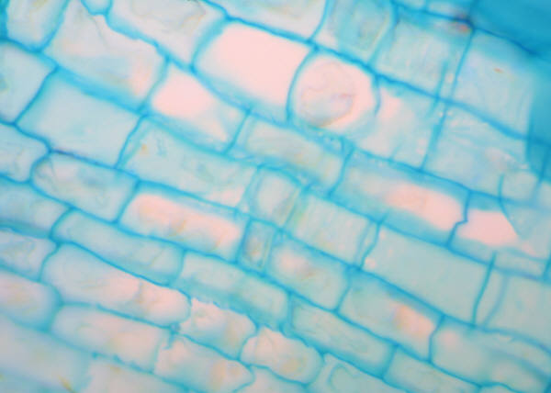
Details are important?
(SPECIFIC INFORMATION—FACTS, EXAMPLES, REASONS)

Slide 57
Cut cartoons from the newspaper and put them onto a transparency;
Read them aloud;
Think aloud the inferences that you make that allow you to perceive the cartoon as funny

Slide 58
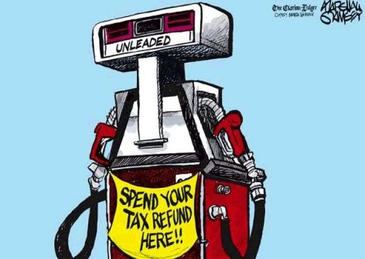

Slide 59
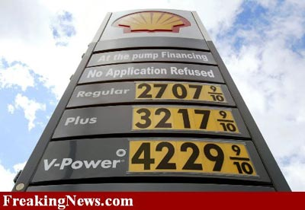

Slide 60
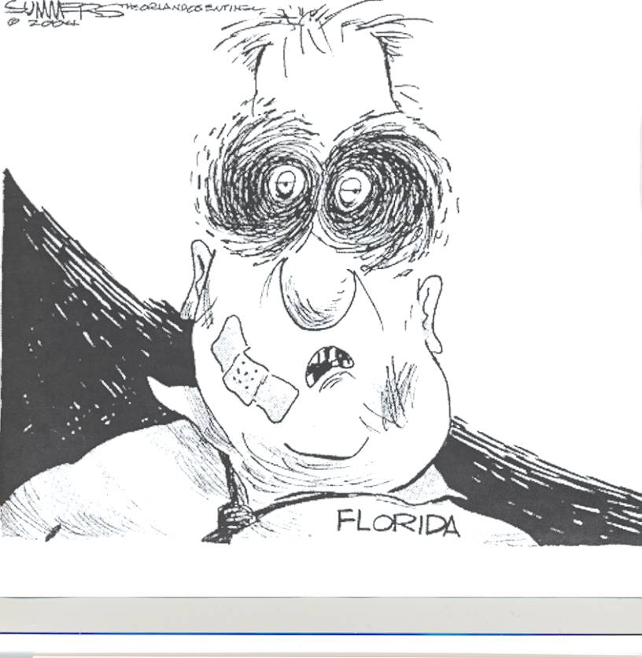
Identify one detail

Slide 61
Messy windblown hair
white skin
Black swirling eyes
Large Band-Aid
Missing broken teeth
Large Black bruise
Dirty stained shirt
Loose sloppy tie

Slide 62
He has
Messy windblown hair
The man has
Pale white skin
Major accident
The man has
Black swirling eyes
Florida
A
Large Band-Aid
He also has
Missing broken teeth
Covers his chin
Large Black bruise
is on his face
A
He is wearing a
Dirty stained shirt
The man has a
Loose sloppy tie

Slide 63
Inference
Florida has been beaten up by the hurricanes..

Slide 64
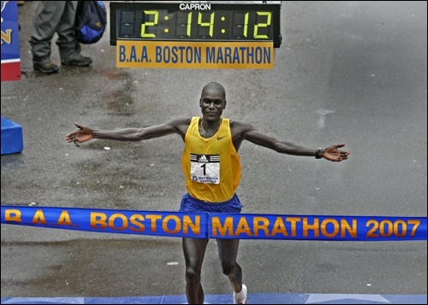
Photographs
This man ran in the Boston Marathon.
This man has finished the marathon.
This man is in pain.

Slide 65
Photographs
This man ran in the Boston Marathon.
This man has finished the marathon.
This man is in pain.

Slide 66

Teach inferences using bumper stickers or signs
Instruct students to write the internal text that comes from the external text.

Slide 67






Slide 68






Slide 69
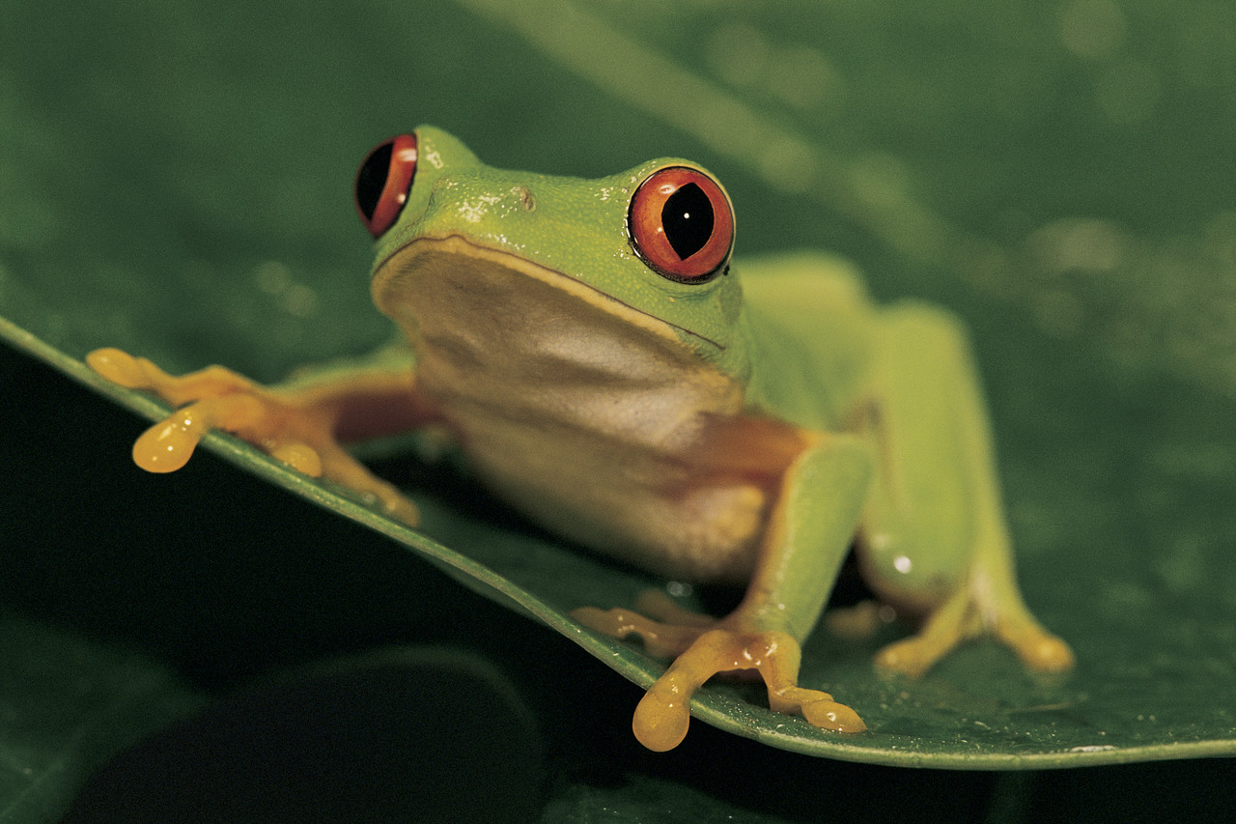
Inferences can be deadly and wrong!
Notes:
There was a professor who was doing experiments with a frog. He was teaching a frog to jump. The training went on for a while and finally when he said, "Jump!" the frog would jump high in the air. He thought it was time to take some measurements and publish the results.
He started his measurements with a twine, a ruler and a knife. He placed the frog on a wooden cutting plate and said, "jump“. It jumped, and he measured the height it jumped.
He wrote in his observation note book: "Height jumped (with 4 legs): 14 inches. Inference: None."
Then he cut off one of the legs of the frog and said “jump”. It jumped to a height of 10 inches. Inference: None.
Then he cut off the next leg, and measured the height jumped. Because it had only 2 legs, the height jumped was only 5 inches. The professor cut off one more leg and the frog now had only one leg. The height jumped was just 1 inch with one leg. Again the inference was none.
Then he cut the last leg off of the frog and said, "jump!" It didn't move at all.
He wrote his inference in the note book: "When all four legs are removed, frogs go deaf."

Slide 70

Inferences from Text
Reading between the lines

Slide 71
Guidelines for Inferences in Reading:
Never lose sight of the available information.
As much as possible, base inferences on the facts.
Use background information and experience to help make inferences. The more background information people have, the more accurate their inferences are likely to be. So keep in mind that some inferences may be difficult to support.

Slide 72
Consider the alternatives.
Considering alternative interpretations of the facts is one way to zero in on a likely interpretation.
Don’t simply accept the first inference that comes to mind. Instead, consider all of the facts of a case and all the possible explanations.
Go back into the passage to find support for the inference.

Slide 73
“Read between the lines,”
Pick up ideas that are not directly stated in what you are reading.
These implied ideas are usually important for a full understanding of what an author means.
Discovering ideas that are not stated directly is called making inferences, or drawing conclusions.

Slide 74
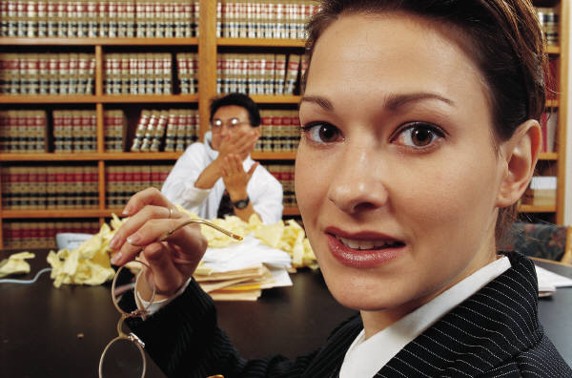
Witnesses who say that someone else told them a certain thing cannot present this information as evidence in court. It is called hearsay and usually cannot be trusted or confirmed by cross-examination. There are many exceptions to the rule that hearsay cannot be accepted; one of the most interesting exceptions is a dying declaration. It is assumed that a dying person

Slide 75
Witnesses who say that someone else told them a certain thing cannot present this information as evidence in court. It is called hearsay and usually cannot be trusted or confirmed by cross-examination. There are many exceptions to the rule that hearsay cannot be accepted; one of the most interesting exceptions is a dying declaration. It is assumed that a dying person
A. deserved a trial.
B. is innocent.
C. was murdered.
D. tells the truth.

Slide 76
Witnesses who say that someone else told them a certain thing cannot present this information as evidence in court. It is called hearsay and usually cannot be trusted or confirmed by cross-examination. There are many exceptions to the rule that hearsay cannot be accepted; one of the most interesting exceptions is a dying declaration. It is assumed that a dying person
A. deserved a trial.
B. is innocent.
C. was murdered.
D. tells the truth.

Slide 77
1
The operator of a news-stand reported to police that a customer asked for change for a large bill but actually had left a small bill. The police soon brought the vendor a suspect. Although the news-stand operator was blind, the suspect was proven guilty of the fraud by the fact that the vendor recognized the suspect’s

Slide 78
The operator of a news-stand reported to police that a customer asked for change for a large bill but actually had left a small bill. The police soon brought the vendor a suspect. Although the news-stand operator was blind, the suspect was proven guilty of the fraud by the fact that the vendor recognized the suspect’s
A. voice B. fingerprints
C. photograph D. clothes

Slide 79
The operator of a newstand reported to police that a customer asked for change for a large bill but actually had left a small bill. The police soon brought the vendor a suspect. Although the newstand operator was blind, the suspect was proven guilty of the fraud by the fact that the vendor recognized the suspect’s
A. voice B. fingerprints
C. photograph D. clothes

Slide 80
When European kings in the eighth century took up the practice of having themselves anointed by the Church, they became thought of as God's own appointed rulers. To oppose such a king was then thought to be not only treason, but
Notes:
What is the right answer?

Slide 81
When European kings in the eighth century took up the practice of having themselves anointed by the Church, they became thought of as God's own appointed rulers. To oppose such a king was then thought to be not only treason, but
A. a felony. B. unwise.
C. criminal. D. a sin.

Slide 82
When European kings in the eighth century took up the practice of having themselves anointed by the Church, they became thought of as God's own appointed rulers. To oppose such a king was then thought to be not only treason, but
A. a felony. B. unwise.
C. criminal. D. a sin.

Slide 83
When European kings in the eighth century took up the practice of having themselves anointed by the Church, they became thought of as God's own appointed rulers. To oppose such a king was then thought to be not only treason, but
A. a felony. B. unwise.
C. criminal. D. a sin.

Slide 84
Transfer
Inferences
Often help readers to make connections from known information to unknown
Require interaction between prior knowledge and the text
Require an analysis of the logic of what is being read (applying intellectual standards such as clarity, precision, accuracy, relevance, significance, depth, and fairness)
History
Events
Biology
living things
Mathematics
numbers, shapes, and figures

Slide 85
Thank You

Slide 86
Inferences http://www.tv411.org/lessons/cfm/reading.cfm?num=11&act=2&que=1
http://ethemes.missouri.edu/themes/1666
http://ethemes.missouri.edu/themes/1666

